Slide 1
Polyglot Persistence
#GlobalAzure
David Makogon, Microsoft
@dmakogon

Slide 2
Agenda
Data landscape
Azure and data
Key/value
Document
Graph
Column
Polyglot persistence

Slide 3
The Data Landscape

Slide 4
So much data!
90% of the world’s data has been created in the last two years….
George Lee. Chief Information Officer, Investment Banking Division, Goldman Sachs

Slide 5
Data growth
130 billion gigabytes in 2010
4.4 trillion gigabytes* in 2013
IDC projections:
44 trillion gigabytes by 2020
180 trillion gigabytes by 2025
* 1 Zettabyte = 1 trillion gigabytes

Slide 6
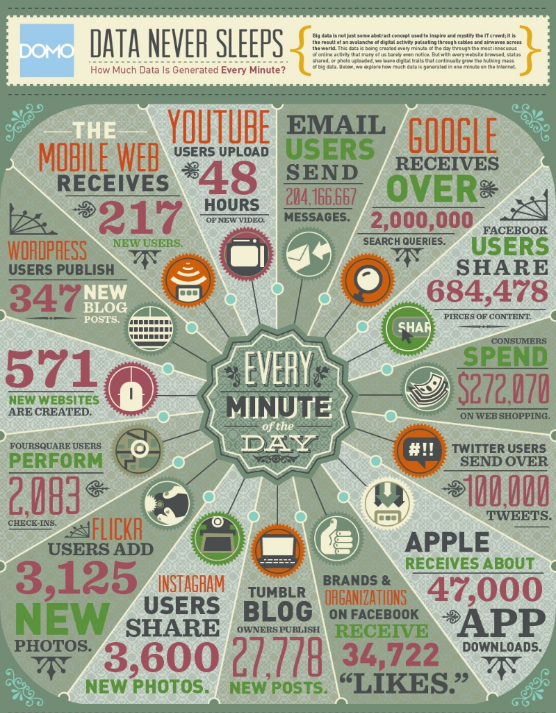
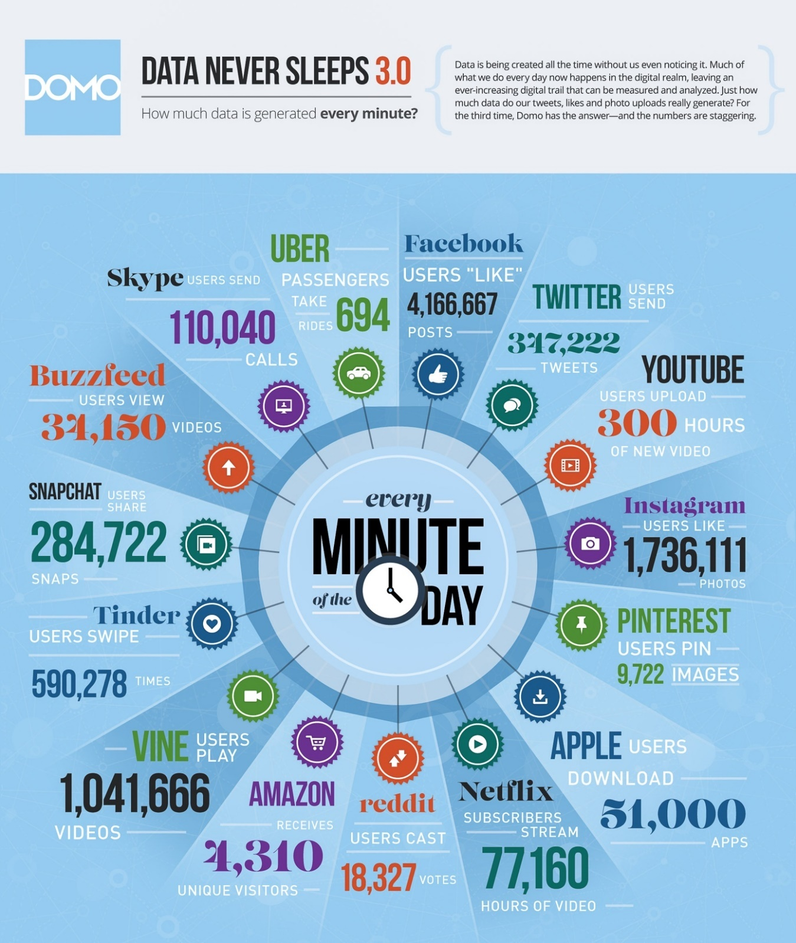
2012
Notes:
Every minute of every day - YouTube users upload 48 hours of video, Facebook users share 684,478 pieces of content, Instagram users share 3,600 new photos, and Tumblr sees 27,778 new posts published …
oh wait, that was in 2012 …
The first infographic, for example, showed that Facebook users shared 684,478 pieces of content.
Fast forward a couple of years and that number has exploded to a staggering 2,460,000 pieces

Slide 7

 | 2012 | 2015
YouTube | 48 hours | 300 hours
Twitter | 100,000 tweets | 347,000 tweets
Instagram | 3,600 shares | 1.7 million likes
Facebook | 684,000 shares | 4.1 million likes
Vine | Non-existent | 1 million views
Snapchat | Non-existent | 285,000 snaps
Tinder | Non-existent | 590,000 swipes
Data generated per minute:

Slide 8
The shape of data

Slide 9
The shape of data
Data varies in structure:
Structured, Semi-Structured, unstructured
Data is not used in the same way:
Some data relates to other data
Some data is related to many other pieces of data
Some data is self contained
Some data is queried, some is reported on

Slide 10
The shape of data
90% of the world’s data has been created in the last two years….
The ultimate question is really what insight and value can we draw from that data.

Slide 11
The shape of data
It’s not just about Relational anymore … “NoSQL”
Multiple database categories and data shapes
Relational
Document
Key/Value
Graph
Column
Notes:
NoSQL – even though that term is so overused and completely misses the point

Slide 12
Relational databases

Slide 13
What’s a relational database?
Set-theory-based
Two-dimensional relations (or tables)
Tables have columns
Column data is strongly typed, types enforced by system
Tables have tuples (or rows)
Selections (WHERE…)
Projections (SELECT…)
Cartesian products (JOIN …)
Notes:
Model that generally comes to mind when thinking about databases
Most people believe that relational databases are called this because tables relate to other tables through some form of constraint;
This is untrue. They are called relational databases are relational based on mathematics.
Luckily the majority of RDBMS systems hide most of this mathematics from the user
So the next time you think, jeesh, why did I learn algebra at school I never use it, think again. You have probably used algebra a lot more than you want to admit ☺

Slide 14
Why a relational database? Optimal:
Robust, stable, years of proving itself
Homogeneous data conforms to a structured / rigid schema
Flexible query-ability
Very consistent & durable data
ACID transactions

Slide 15
Less optimal?
(Typically) Scale up
Requirement for flexible data
Impedance mismatch (ORM mapping)

Slide 16
Playing with SQL
Tables with columns and rows, with relationships to other tables
SQL query language
SELECT p.FirstName, p.LastName, c.Number, a.City
FROM Person p
INNER JOIN ContactDetails c ON c.PersonId = p.Id
INNER JOIN Address a ON a.PersonId = p.Id
WHERE p.Language != “eng-us”
ORDER BY a.City, p.LastName

Slide 17
Options in Azure?
PaaS
Azure SQL Database
MySQL
IaaS
SQL Server on VMs
Oracle Database
MySQL
PostgreSQL
And so many more ….

Slide 18
Data in Azure

Slide 19
The choice is yours
PaaS: Database-as-a-service
Microsoft
3rd-party
IaaS: BYOD
Manual spin-up
Your own ARM scripts
Vendor-built ARM scripts

Slide 20
Relational databases (yes, I lied)

Slide 21
Key/value databases

Slide 22
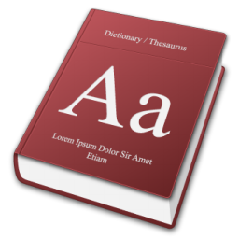
What’s a key/value store?
Effectively, this ->
You have some form of Key, Which you use to look-up an opaque Value

Slide 23
Why use a Key/Value store?
Very rapid, discreet look-ups
When you always know the Key
When you only ever query by Key

Slide 24
Less optimal?
Searching on properties within the Value
Complex queries

Slide 25
Options in Azure?
PaaS
Azure Table Storage
Redis Cache service
IaaS
Redis
Riak
Memcached
And so many more ….

Slide 26
Document databases

Slide 27
What’s a document database?
NOT for this kind of document !

Slide 28
What’s a document database?
{
“id": “13244_user",
"firstName": "John",
"lastName": "Smith",
"age": 25,
"address":
{
"streetAddress": "21 2nd Str",
"city": "New York",
"state": "NY",
"postalCode": "10021"
},
“mobileNumber": "212 555-1234"
}
For this kind of document -

Slide 29
What’s a document database?
Part of the NoSQL family of databases
Built for simplicity, scale and performance
Non-relational, no schema enforced
Flexible query options

Slide 30
Developer Appeal
Promotes code first development
Resilient to iterative schema changes
Richer query and indexing (compared to KV stores)
Low impedance as object / JSON store; no ORM required
It just works
It’s fast (to get going, and in txs)
I
developers

Slide 31
Use Cases and Applicability
Mobile and Web
User data store
IoT scenarios
Event workflow and logging
Data ingestion and presentation
Product catalogs
Notes:
Mobile and Web apps – metadata for content oriented apps
User data store – user profile and behavior data
IoT scenarios – queryable device and event store
Event workflow and logging
Data ingestion and presentation – ingesting data with variable schema with rich views over the data
Product catalogs

Slide 32
Less optimal use
Complex relational data
Complex map/reduce aggregations
Distributed transactions
OLAP

Slide 33
Options in Azure?
PaaS
Azure DocumentDB
mLab, MongoDB, Compose
RavenHQ
Iaas
MongoDB
CouchDB
Couchbase
ArangoDB
And countless more …

Slide 34
Example query: DocumentDB
SELECT * FROM f WHERE f.id = "AndersonFamily"
var query = from f in client.CreateDocumentQuery<Family>(collectionLink)
where f.Id == "AndersonFamily"
select f;

Slide 35
Graph databases

Slide 36
What’s a graph database?
Nodes and relationships
And properties
And all the query stuff

Slide 37



What’s a graph database?
Maybe I should see that movie…
I reviewed that movie!
Reviewed
Friends with

Slide 38
Why a graph database? Why not?
Optimal:
Ideal for complex connections
Easy navigation between things (nodes) and connections
No need for complex joins
Easy to add to (and evolve) existing model

Slide 39
Why a graph database? Why not?
Less-than-optimal:
Complex relational data
OLAP

Slide 40
Options in Azure?
PaaS
Graph Story
GrapheneDB
IaaS
Neo4j
Dex
OrientDB
InfiniteGraph
AllegroGraph
And many more!

Slide 41
Example query: Neo4j
(ryan:Person)-[:FRIENDS_WITH]->(david:Person)
-[:REVIEWED]->(movie:Movie {Title:’Fletch’})

Slide 42
Column databases

Slide 43
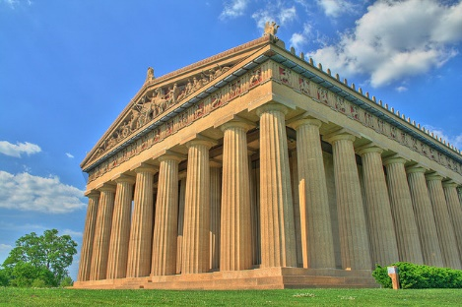
Column stores
Not these columns:
Photo credit: Will Powell – “Nashville Parthenon – HDR”
https://www.flickr.com/photos/powellizer/872909379

Slide 44
What’s a column store?
Data is keyed by row (e.g. Twitter ID)
Individual content stored as columns
Groups of columns comprise a column family

Slide 45
Example: Weather data
Data is keyed by row (e.g. weather station ID)
Columns may have standard or custom names
For weather: Each col name = date
stationID | Timestamp temp | Timestamp temp | Timestamp temp | …
stationID | Timestamp temp | Timestamp temp | Timestamp temp | …

Slide 46
Why a column family? Why not?
Optimal:
Very large quantities of data
Queries well-known up-front
Scale and durability
Non-optimal:
Highly-relational data
Querying on many different properties

Slide 47
Options in Azure?
IaaS
Cassandra
HBase

Slide 48
Using Cassandra + CQL
CREATE TABLE temperature (
stationID text,
readingtime timestamp,
temp text,
PRIMARY KEY (stationID,readingtime)
);
INSERT INTO temperature(stationID,readingtime,temp)
VALUES (‘1’,’2015-02-23 09:00:00′,’45F’);

Slide 49
Finding temperatures
SELECT readingtime,temp
FROM temperature
WHERE stationID=’1’;

Slide 50
Polyglot persistence

Slide 51
Choices, choices, choices!
Relational
Key/value
Graph
Column
Document
Ready… set… CHOOSE!
Hmmm… Not so easy, eh?

Slide 52
Why so difficult to pick one?
Schema enforcement
Reporting
Interconnections
Time-series
Rapid lookup
Scale-out
Scale-up
Durability

Slide 53
Compromises
Referential integrity & transactions
Schema flexibility
Scale
Reporting
Skillsets
HA/DR procedures
3rd-party tools and the ecosystem

Slide 54
Do we have to compromise?
Combine!
Why not?
Maybe… a bit of each?

Slide 55



Imagine… a shopping site
E-Commerce platform
Cart
Orders
Catalog & Reviews
Suggestions
Key/value
RDBMS
Document
Graph

Slide 56
Challenges?
Multiple DB skillsets
More complex HA/DR/Backup procedures
Additional licensing and support
Determining System(s) of Record

Slide 57
Challenges challenged
What’s the effort and cost for?
Avoiding:
INSERT INTO ROUND_HOLE
VALUES (‘SQUARE_PEG’)

Slide 58
Benefits
Use each database type for its strengths
Reduce scope and complexity with a database type

Slide 59
Summary
Choices, choices, choices! How to choose?
Polyglot persistence: A blend of db's working together
Resources:
aka.ms/polyglot – polyglot persistence in-depth
github.com/dmakogon/globalazure2016
github.com/dmakogon/dbguidance

Slide 60
Questions?

